Slide 1


OpenVAS and Securing a Network
BootCon 2023!
Presented by: Omar Rayo-Vazquez

Slide 2
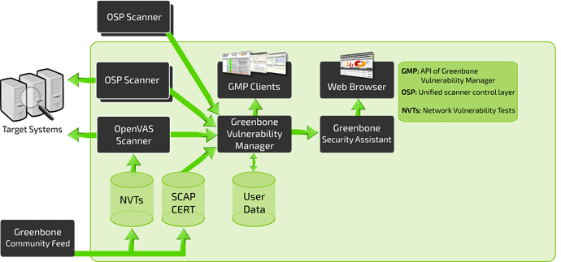
What is OpenVAS?
OpenVAS is a full-featured vulnerability scanner.
Huge Database of NVTs and uses SCAP CERT
GVM Framework Vulnerability/ Information Feed, Backend, Frontend
Credit:tryhackme.com/room/openvas

Slide 3

Why use OpenVAS?
Friendly Reporting!
Offers Solutions!
Able to test IDS and IPS systems
And no I am not sponsored by GVM.

Slide 4


Tools
VirtualBox with 2 Ubuntu and 1 Kali box located on the same subnet
UFW will be used on some Machines
SSH to fix any vulnerabilities and perform authenticated scans
Kali will be the administrator system
The goal is to simulate a small organization that would like a vulnerability test done to it’s systems. Perform mitigations if possible.
Google/Firefox/Bing
Patience for troubleshooting

Slide 5
Vulnerabilities and Mitigations found
Ubuntu: Security Advisory: CVE-2019-17594 (192.168.100.6)Severity:8.8
Solution:
Sudo apt update && sudo apt upgrade && sudo apt dist-upgrade
Then set up UFW firewall and then authenticated scan broke.
P4.1 (192.168.100.4) had the firewall enable from the beginning and the rules were set up the same.
For know the firewall was disabled on P4.2 (192.168.100.6)

Slide 6
Vulnerabilities and Mitigations found
RETbleed: CVE-2022-29900 (all hosts) Severity:6.5
Solution:
POWERSHELL to fix on a VM
$env:PATH = $env:PATH + ";\Program Files\Oracle\VirtualBox"
Then
VBoxManage modifyvm "NAME_OF_VM" --spec-ctrl on
https://forums.virtualbox.org/viewtopic.php?f=7&t=107103
https://www.how2shout.com/how-to/vboxmanage-command-not-found-in-windows-cmd-or-powershell

Slide 7
TCP TImestamps Information Disclosure
TCP Timestamps Information Disclosure (all hosts) Severity: 2.6
Solution:
mitigation: echo "net.ipv4.tcp_timestamps = 0" >> /etc/sysctl.conf && sysctl -p

Slide 8
Why Vulnerability scans are important!
An important point about a vulnerability scan is that it does not attempt to exploit any vulnerabilities. Instead, a vulnerability scan is a passive attempt to identify weaknesses. This ensures that the testing does not interfere with normal operations. Security administrators then assess the vulnerabilities to determine which ones to mitigate.
Gibson, Darril. CompTIA Security+ Get Certified Get Ahead: SY0-601 Study Guide (pp. 758-759). YCDA, LLC. Kindle Edition.
The End

Slide 9
Resources used
www.Google.com
www.Tryhackme.com
https://www.virtualbox.org/manual/ch08.html
https://forums.virtualbox.org/viewtopic.php?f=7&t=107103
https://access.redhat.com/support/policy/updates/errata/#Production_Phases
https://phoenixnap.com/kb/how-to-update-kernel-ubuntu
https://bobcares.com/blog/openvas-reset-admin-password/
https://www.greenbone.net/en/
https://hub.docker.com/r/mikesplain/openvas/dockerfile
https://github.com/greenbone/openvas-scanner/blob/main/INSTALL.md

